Slide 1


Design and Development of a Web Application
in a Containerized Environment
Supervisor:
Prof. Pierpaolo Baglietto
Cosupervisor:
Dott. Marco Risso
Candidate:
Fabrizio Durante
Student ID n. 3941665
Examine the popularity of disassemblers
METHODOLOGY

Slide 2
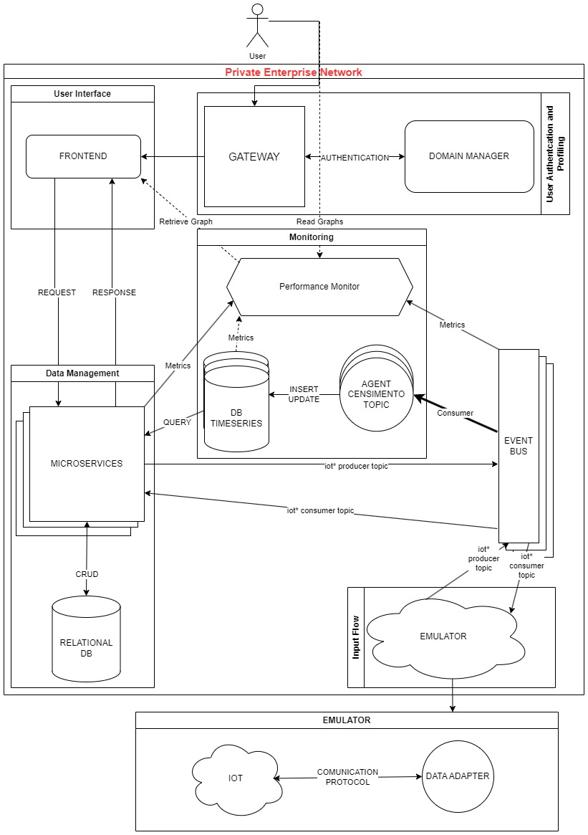
architecture
Groups
Input Flow
Data Management
User Interface
Authentication
Monitoring

Slide 3
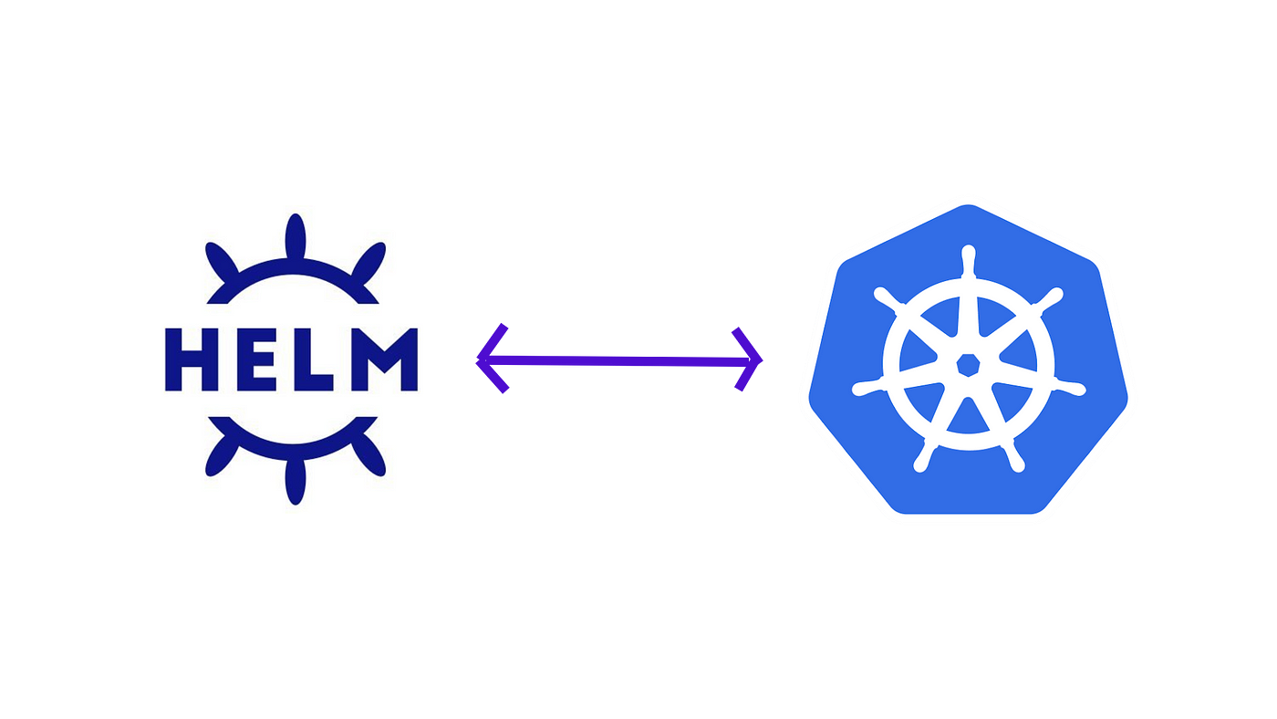
Core technologies
Kubernetes
Container Orchestration Platform
Pod
Controller
Helm
Package Manager for Kubernetes
Charts
Release

Slide 4



Event Streaming Bus
Apache Kafka
ZooKeeper
Message Broker
Topics
Producers
Consumers / Consumer Groups
Distributed Coordination
Quorum
ZNode

Slide 5



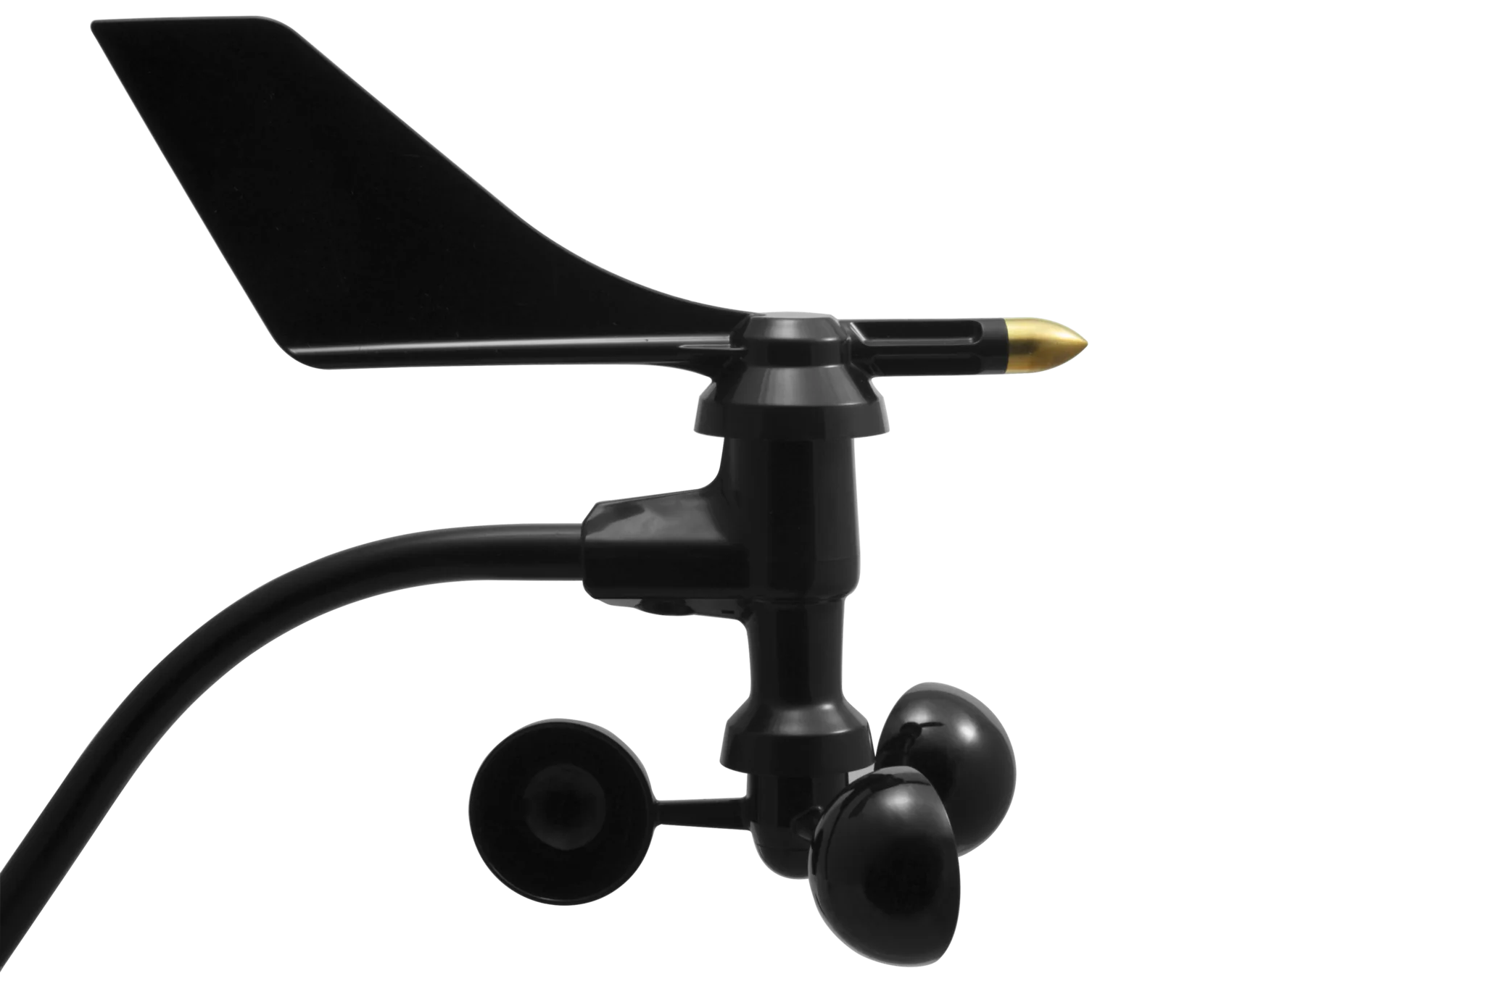


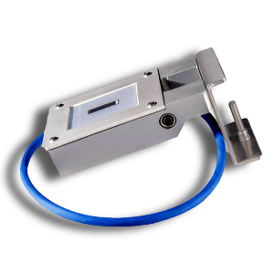
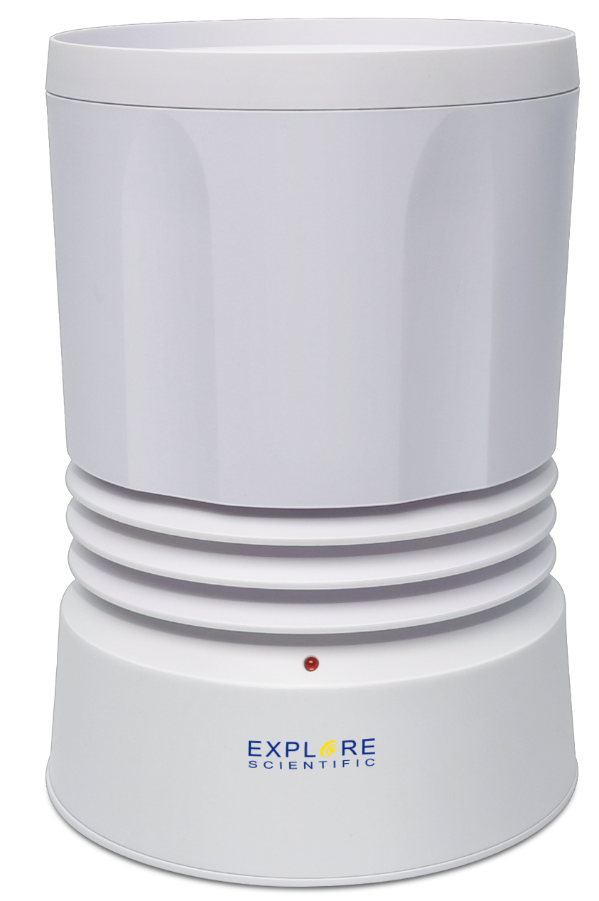

Input Flow
Adapters
Python
Interpreted Programming Language
Dynamic Typing
Easy Kafka Integration
Quite good low-level communication
AdaptersManager

Slide 6
Input Flow
Adapters
Python
Interpreted Programming Language
Dynamic Typing
Easy Kafka Integration
Quite good low-level communication
AdaptersManager

Slide 7


Data Management
User Interface
User Interface
User Interface
SOCKET SERVICE
CONFIGURATION SCHEDULER
REST SERVICE
INPUT FLOW

Slide 8




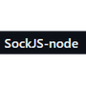
USER interface
UI
AUTHENTICATION
DATA MANAGEMENT

Slide 9


Authentication and user profiling
GATEWAY
DATA MANAGEMENT
User Interface

Slide 10






monitoring
INPUT FLOW

Slide 11




TESTing
UI

Slide 12


CI/CD PIPELINES

Slide 13
results
Login su keycloak

Slide 14
results

Slide 15
results

Slide 16
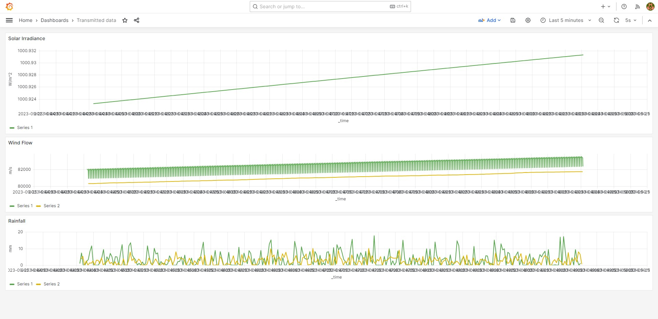
results

Slide 17
CONCLUSION
Robustness
Scalability
Reliability
User-friendliness

Slide 18
Future developments
REST SERVICE
AdaptersManager
Adapters

Slide 19
Future developments
entities
entities_old
CONFIGURATION SCHEDULER

Slide 20
THANK YOU

